Slide 1


MAP
Executive Overview
Notes:
Structure
A little more method overview
Add “Basic Modeling”: objects + actions → info + behavior models (without any diagrams??)
Add fully-worked, tiny case study as posters
Include notation summaries
Main structure should reflect new method documentation

Slide 2
Two Aspects of the MAP Framework
Formal Architecture Framework
Goals
Viewpoints
Concerns
Models
Refinement
Architecture Styles
Process Pragmatics
Routes: Roadmap, Construction, …
Different Entry Points
Iterative and Incremental
List, Draft, or Dressed Templates
Guidelines
Checklists
Architecture always ties back to goals.
Different presentation suitable to audience
Clear and unambiguous architecture
Consistency rules across descriptions
How to prioritize and focus work?
How much detail is appropriate and when?
How to show early value and reduce risk?
How to customize to project needs?

Slide 3


What is MAP?
MAP – Model-Driven Approach for clear, business-aligned, architectural solutions
MAP is a systematic approach to plan, architect, develop, and evolve software systems
  Clearly separated viewpoints and models to design or analyze an architecture
1. Business Driven
business goals, terminology, process first
relate disparate views
relate multiple systems, programs, initiatives
2. Traceability
bridge Business and IT
precise shared vocabulary
critical business questions early
5. Reuse Process
reuse business models
… and architectures
… and implementations
develop for reuse
develop with reuse
4. Consistent Architecture
blueprint for consistency
principles, patterns, styles
both business and technical
standards for interoperability
3. Design and Assemble Pluggable Components
federated components, services; not monolithic systems
clear interfaces and responsibilities
reusable and maintainable building blocks
Builds upon best practice and industry standards for architecture: UML, EDOC, RM-ODP, Catalysis, Simple Components, RUP, Problem Frames, Goal Modeling

Slide 4


What Questions Does MAp Ask?
What are the properties of the box visible at its boundary?
functionality: services offered and
required, events handled,
information handled
others: volumes, performance,
location, security, tech platform
Why? What is the bigger goal being achieved outside? How is our box combined with other parts to solve it?
Are there better approaches?
What is the boundary of the “box”
we are describing?
Workers
Policies
Our Box
Resources
What internal “boxes” can be combined to do the job?
Existing or New boxes?
How to partition behavior and information responsibility to meet end-to-end needs?
What are the properties of each internal box?
functionality: services offered and
required, events handled,
information handled
others: volumes, performance,
location, security, tech platform
What consistent principles, patterns, or styles guide our design and are shared across components?
How should we document all these?

Slide 5
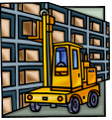



Goals to Components, Concerns
7: Multiple concerns: functionality, security, performance, technology…
2: Goal - Factories supplied just in time from supplier warehouses
Functionality
Security
Performance
Technology
…
1: Problem Domain – factories, supplies, warehouses, partners, existing systems
3: Refinement to sub-goals on sub-domains
3b: predict production load, optimize supply schedule
3c: make deliveries
3a: track inventories
4: Scope of sub-goals get narrower.
Some assigned to components.
Factory Supply Optimizer
production load predictions
supply scheduling
supplier
inventory
deliveries
scheduling
predictions
5: Applications, Components, Connectors
– specifications for each one
– end-to-end satisfaction of goals
6: Applicable to any granularity of goals and components

Slide 6
MAp Viewpoints
Information supports goals, process
Process supports goals
Domain / Biz
Architecture
1
Outside
Domain: Information, events
Goals
Process
Goals – success criteria
Black box assembly includes S,
Supports business model
Traceability
Mapped Black box Assembly (including S)
1
S
Component Architecture
Black box Spec (of S)
S
E
D
S
1
2
S: Information
Boundary
Architecture Styles: Principles, Patterns, Guidelines, Rules
Black-box Specification (of S)
4
S: Behavior
3
Black box view of S
Architecture styles, patterns: across viewpoints, projects
White box view of S
sub-component s1…s3
Partitions behavior & information
1
2
S
S
Component Architecture
White box design (of S)
s2
Inside
s2
s1
3b
s1
s3
3a
s3
4
Information
Behavior
Each sub-component could be drilled-down if needed

Slide 7
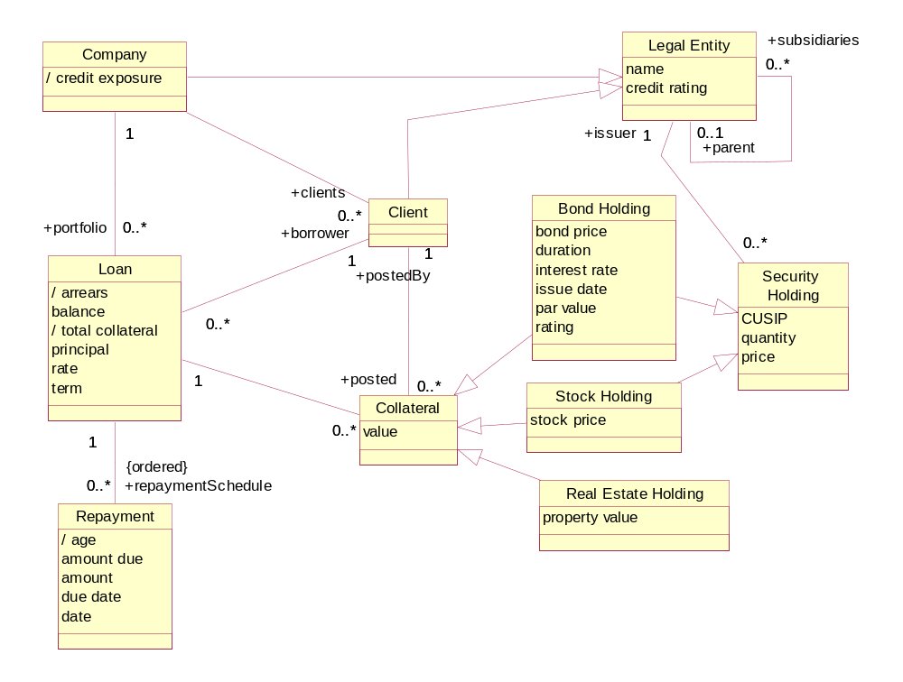
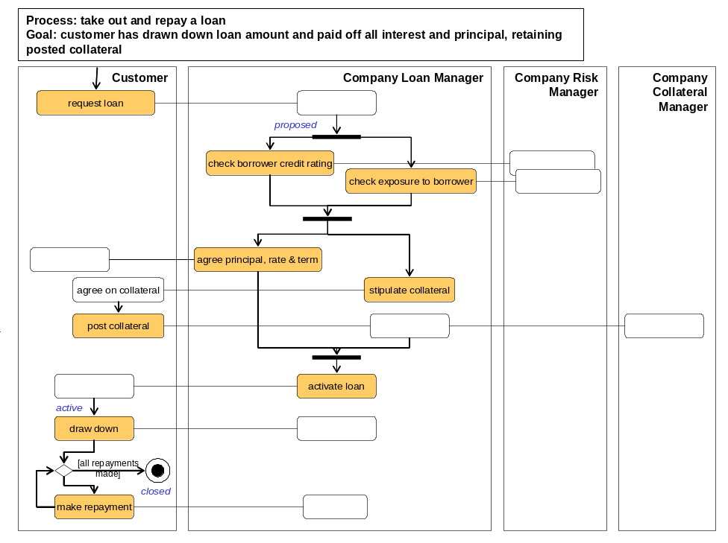
Loans Example – Goals, Domain Model, Biz Process Model
Goals clearly defined in domain terms.
Goals refined into adequate sub-goals
Subgoals checks: necessary? sufficient?
Minimize Credit Exposure Risk
Maximize Return
Predict Risk
….
Adjust Risk Exposure Factors
…..
Unambiguous definition of domain terms
  Object types, attributes, events
Terms defined in “drill-down” as needed
Track Risk Prediction History
Improve Predictive Model Over Time
Process activities clearly defined in domain terms
Business process demonstrably supports goals

Slide 8
Example – Black-box partition & mapping of Domain Model
Clear authoritative ownership of information by top-level components
Top level “black-box” components
Loans System
Reference Data System
Collateral Management
System
Explicit dependencies between information across components, will be treated as split objects with a <<cross-system>> association

Slide 9
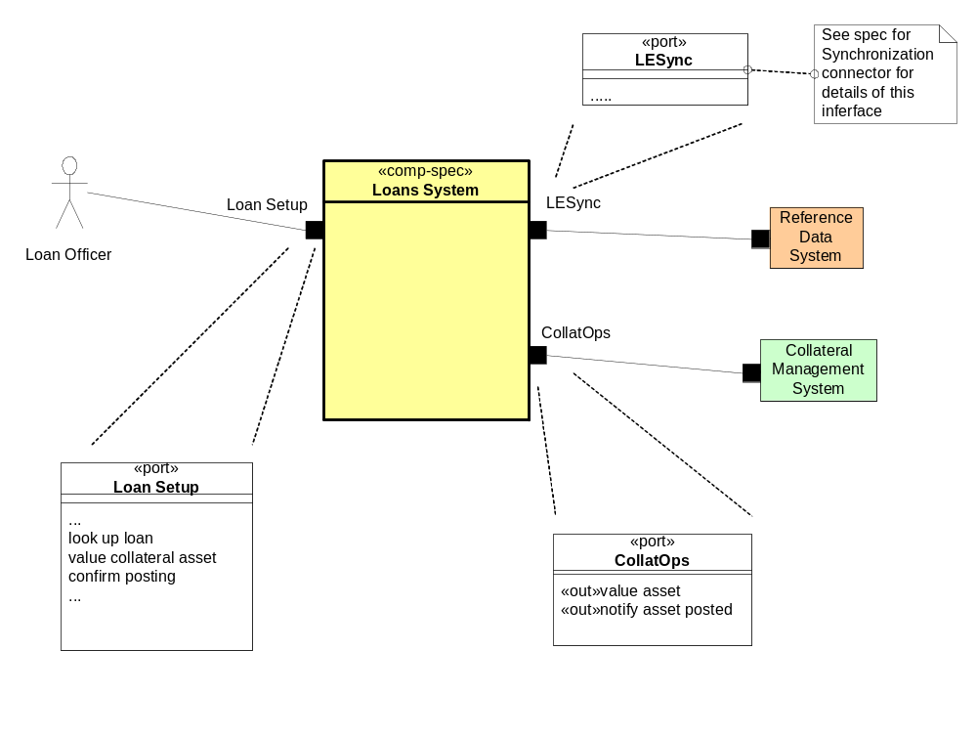
Example – Black Box Assembly
Ports  define connection points on components
Services provided and required explicit
Logical connections between components clear
Clear underlying information ownership
Loans System
Reference Data System
Collateral Management
System
Interfaces specified explicitly

Slide 10

MAp can provide complementary value to an SDLC
MAp
Roles
SDLC
1
PM Submits
Request
1
Outside
QA
Approval
Domain: Information
Goals
Biz. Process
Yes
Task
Complete
Black box Assembly (including S)
No
S
1
S
1
S
Lifecycle Process
PM Accept
Task to be
Completed/
Corrected
E
D
2
Boundary
Yes
2
S: Information
Architecture Styles: Principles, Patterns, Guidelines, Rules
Black-box Specification (of S)
S: Behavior
3
4
No
PSA
Override
Task
Complete
Yes
S
1
S
2
No
s2
s1
s2
Inside
Task Must be
Completed/
Corrected
s1
s3
3a
3b
s3
Information
Behavior
4
Document Templates
3
Adapt MAp to the SDLC structure for the organization
  If possible follow a somewhat iterative lifecycle
Add specific useful tools within the SDLC
  How to frame the problem and clarify the domain terminology
  How to derive and validate key architecture decisions
Fill in key parts of templates e.g. Business Requirements, Functional Specs
  Model of goals and it’s refinement to architecture decisions
  Specification of services, components, connectors
Define relations and consistency criteria across descriptions

Slide 11
Roadmap
Route
Initial issues, objectives, stakeholders, etc.
buried business knowledge
refine goals and obstacles
for target state work
Frame the Problem: formalize problem, syndicate with stakeholders
Goals model Key domain terms
known reference architectures,
best practices, etc.
top-level problem definition,
domain terms to map,
priorities, focus areas
Analyze The Current State
Define The Target State
Business architecture
scenarios and process sketches
key information terms
problems and opportunities
Business architecture
principles and styles
processes, roles, activities
validation vs. goals and obstacles
problems and opportunities
Component architecture:
principles and styles
[black-box] top-level assembly
[black-box] context: ports, use cases
[white-box] sub-component assembly
[white-box] end-to-end collaborations
technical properties, mapping styles
validation vs. goals and obstacles
target reference architecture
e.g. components, functions,
information … for inventory
Component architecture
application inventory and map
(against domain, target reference)
non-functional and technical props
problems and opportunities
Plan The Migration
relationship to other roadmaps and projects
goals, constraints, architectural sequencing dependencies
migration principles, stages: evolving architecture snapshot with gaps, cost
cross-project
“program” conformance
project funding
project requirements
project funding
project requirements
project funding
project requirements

